Slide 1
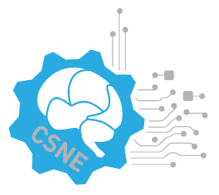

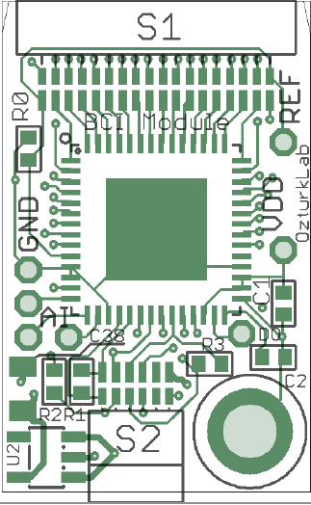
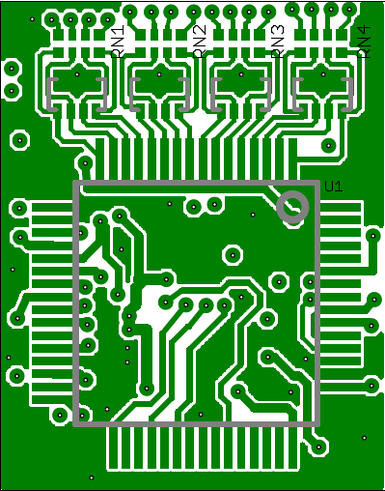
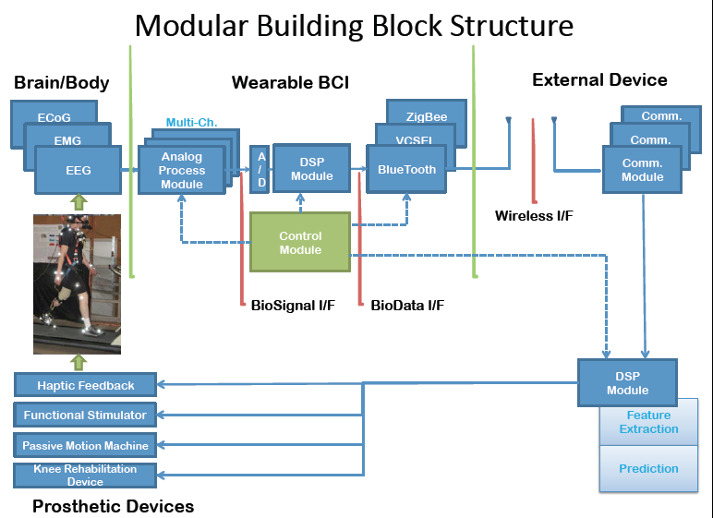



An Active Connected Knee Rehabilitation Device
Yi Su, Yeongjee Chung, Kee Moon, Yusuf Ozturk
Department of Electrical Engineering, Department of Mechanical Engineering, San Diego State University, CA
Introduction
Results
Discussion
A wearable wireless device for measuring muscle activity and muscle tension is developed. The novel optical muscle activity sensor detects muscle tension and correlates with limb position.
A low power wireless protocol is developed to monitor the sensor remotely.
A component based approach to Brain Computer Interfaces is developed. Two analog front end solutions for external EEG is developed. An open source BCI software driver is developed to acquire EEG signals, process and visualize the data using the open source hardware developed.
16 channel and 8 channel differential BCI modules
Conclusions
Methods
Component based standardized modules for implementing a Brain Computer Interface
Rehabilitation Device Control
Profile based common Platform for Configuration/Control
Rehabilitation Program Database
References

